Slide 1
Predictive Model to Reduce Student Dropouts in M.Tech using Decision Tree
Batch No:17CSEC008
Team Members: Team Supervisor:
M. Akhileswari (17K61A0565) Mrs. A.N.V.K.Swarupa
S. Nagaraju (17K61A0596) Assistant Professor
K. Sai Bhargavi (17K61A0559) Dept of CSE
Y. Navya (17K61A05B5) Sasi Inst. of Tech & Engg.

Slide 2
List of Contents
Abstract
Analysis
Module split up and Gantt chart
Problem statement
Aim and Objective of project
Literature review
Detailed design
Module detail explanation
Experimental Results
Result Analysis
Comparison with Existing system ( Table/Chart)
Conclusions and scope for future work
Contribution of the candidate
References

Slide 3
Abstract
Nowadays, there is a rapid growth and improvement within educational zone. But there is an increase in academic dropouts in M.Tech due to various reasons like ambiguity in domain selection, lack of student’s knowledge in selected domain. So, to overcome these problems we are developing a predictive model to predict the rate of academic dropout chance based on the domain they are interested and the income of their parents and the marks that they gained in the B. Tech.
The prediction of chance of dropout rate helps the student to take care about his/her career by declining their concern of dropout in M.Tech. The prediction of chance of dropout rate can be done by using data mining technique Decision tree.
Keywords: Student dropout , Decision tree , Student performance , Data mining.

Slide 4
Module Split up
Calling class
Binary node
Decision tree

Slide 5
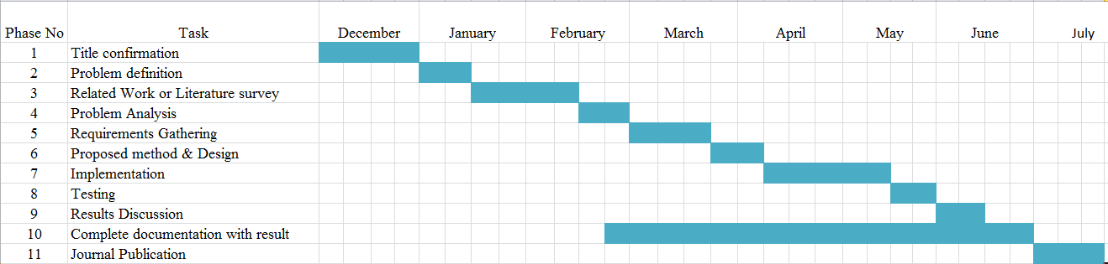
Gantt Chart

Slide 6
Problem Statement
If a student is in his final year and he interested to study M. Tech .Then they might be a chance of dropouts due to the unawareness of the skills they require, how much cost it takes and the knowledge they possess . They have a confusion where they can pass or dropout during there studies .
From the previous researches we can observe that if do prediction after student joining in to the course then we can’t solve entire problem. Only we can save some people from dropout. So here we need an early prediction system which predicts student’s interest before he chooses the course and we can predict the chance of dropout rate based on the student graduation marks on that subject. Then definitely he can’t dropout due to lack of knowledge in choosing domain. Then we can save cent percent people from the dropout due to this reason. And we do prediction using income of the student family also. So we can reduce the dropout rate due to financial issues.

Slide 7
Aim and Objective of the Project
The main aim of the project is to predict the rate of chance of academic dropouts based on the domain they are interested and the income of their parents and the marks that they gained in the B. Tech .
The prediction of dropout rate helps the student to take care about his/her career by declining their fear of dropouts in M . Tech.
The prediction of dropout can be done by using data mining techniques like decision tree .

Slide 8
Literature Survey
Title | Concept
Antonio Jesus Fernandez Garcia, Roberto Rodriguez- Echeverria, Juan Carlos Preciado Jose Maria Conejero Manzano , and Fernando Sanchez-Figueroa .”Creating a Recommender System to Support Higher Education Students in the Subject Enrollment Decision”, IEEE Journal,Vol.08,pp.189069-189088,2020. | Problem Statement: Despite the fact that the quantity of college students has increased, the quantity graduating is still now not sufficient to offer society with as many as it requires. Proposed Approach: Decision Support System: Focuses on maximizing graduation rates by constructing a Recommender System to assist students with their selection of subjects. Result: Created a Decision Support System based on a Recommender System using a dataset with few instances that is able to assist students in selecting the subjects best suited to them. Merits: Deals with both prediction and ambitions at student’s decision making. Demerits: Doesn’t provide effective follow-up of Student’s academic path in comparison with the system recommendations.

Slide 9
CONTINUE
Title | Concept
Shaojie qu1,Kan li2,Shuhui Zhang1,And Yongchao Wang3.” Predicting Achievement of Students in Smart Campus”, IEEE, Journal,Vol.06,pp:60264-60273,2018. | Problem statement: Isolate data among different campus information systems and not much effective information among the big data generated by these systems cause that it is a challenge for predicting achievement of students. Proposed Approach: Proposed a layer-supervised multi-layer perceptron (MLP)-based method to predict the achievement of students. Result: Compared with SVM, Naive Bayes, logistic regression, and MLP, the proposed method gets a better performance. Merits: Supervisions are fed to each corresponding hidden layer of MLP to improve the overall performance of student achievement prediction. Demerits: It didn’t pay more attention on weblogs details to find the behaviour pattern of students.

Slide 10
CONTINUE
Title | Concept
David Baners, M. Elena Rodriguez and Montse Serra, "An Early Feedback Prediction System for learners At-risk within a First-year Higher Education Course", IEEE Transactions, vol:12, pp:249-263, 2019. | Problem statement: Identifying at-risk students as soon as possible is a challenge in educational institutions. Proposed Approach: Proposed a predictive model named as Gradual at-risk (GAR) model used to detect at-risk students. GAR model is works on students grades only. Here J48 decision tree classification algorithm is used. Result: An early Warning System along with an early feedback system is created to asses students and reduce risk of failure . Merits: Early detection of potential at-risk students, better guidance for students and increment of interaction with students. Demerits: We need to improve the accuracy of the system by enhancing some other features, and we predict student’s performance after joining into the course.
Josep Figueroa- Canas and Teresa Sancho-Vinuesa, "Early prediction of dropout and final exam performance in an online statistics course", IEEE Transactions, vol: 15, pp: 86-94, 2020. | Problem statement: Higher education students who either do not complete the courses they enrolled on or interrupt their studies indefinitely remain a major concern. Proposed Approach: Proposed a Learning Analytics (LA) approach. It classify at-risk students into two categories: dropout-prone and fail-prone. Here binary decision tree classification model is used. Result: It reduces students dropouts by using Learning Analytics approach. Merits: It provides a simple and interpretable procedure to identify dropout-prone and fail-prone students before halfway point of the semester. Demerits: It has low classification performance values, and we calculate the performance of the students after joining into the course.

Slide 11
CONTINUE
Title | Concept
Camilo Ernesto López Guarín, Elizabeth León Guzmán, and Fabio A. González,“A Model To Predict Low Academic Performance at a specific Enrollment Using Data Mining”,IEEE,Journal,Vol.10,pp:119-125,2015. | Problem statement: Applying an Educational Data Mining Approach to model academic attrition (loss of academic status). Proposed Approach: In this paper they have used two data mining models to predict the loss of academic performance at a certain time by using, not only socio-economic data, but also the academic records. Result: Two learning algorithms, naïve Bayes and a decision tree, were used to build classification models to predict the loss of academic status due to low academic performance on two undergraduate engineering programs. Merits: The Data models they used are high accurate to predict the student performance . The decision tree they have used requires less effort to the prediction of the students information. Demerits: The data models they have used are inaccurate to find the students performance when grade points are in count.

Slide 12
CONTINUE
Title | Concept
Abdullah Alshanqiti And Abdallah Namoun, “Predicting Student Performance and Its Influential Factors Using Hybrid Regression and Multi-Label Classification”,IEEE,Journal,Vol.08,pp:203827-203844,2020. | Problem statement: Understanding, modelling , and predicting student performance in higher education poses significant challenges concerning the design of accurate and robust diagnostic models. Proposed Approach: In this paper they have predict the student information based on the factors they influencing the success of the students. Result: They proposed and validated an intelligent hybrid approach for predicting student academic grades while determining the dominate factors that led to predicted performance. Merits: They have used the fuzzy rules and matrix factorization which they no need more data to train the data and the simplicity and the interpretability to train the datasets. Demerits: They have predicted the data only on the online learning platform but not the data they have been used non online platform.

Slide 13
CONTINUE
Title | Concept
Jui-Long Hung, Morgan C Wang , “Identify At-Risk students for Early interventions-A Time Series Clustering Approach”. IEEE, Transactions,2017. | Problem statement: In this findings also enable online instructors to develop corresponding instructional via course design or student-teacher communication. Proposed Approach: Distance learning, engineering education, higher education, the final course provides useful input for future development and a more effective student-focused. Result: The result indicate that the best model has high practical value to capture at-risk students while the course is still in progress. Merits: A decision tree is a decision support tool that uses a tree-shaped graph or model for classification. It is a supervised learning method. Demerits: F students might be a little behind or less engaged than other students in the class. The long holiday break servers as a catalyst to trigger the at risk.

Slide 14
CONTINUE
Title | Concept
Rosa M. Carro , Alvaro Ortigosa, “From Lab to Production: Lessons Learnt and Real Life Challenges of an Early Student-Dropout Prevention System” IEEE, Transactions, Vol.12,pp:264-276,2019. | Problem statement: Now a days its also support the recording of the resulting retention-oriented interventions for the further analysis . Proposed Approach: Proposed SPA( Sistema de Prediccien de Abandon, dropout prediction system in Spanish), an early warning system that uses these models to generate static early dropout-risk prediction and dynamic periodically updated ones. Result: Among all the retention actions, phone calls seem to be more effective than written interactions. Merits: It provided a reasonably Good separability of classes, close to the performance of the Random Forest models tested in the lab: addressing all the students with dropout risk scores greater than 25% would have covered 60% of real dropouts and 20% off persistent students. Demerits: Good result achieved in the laboratory may not be possible in the long term in a real production system due to sustainability issues.

Slide 15
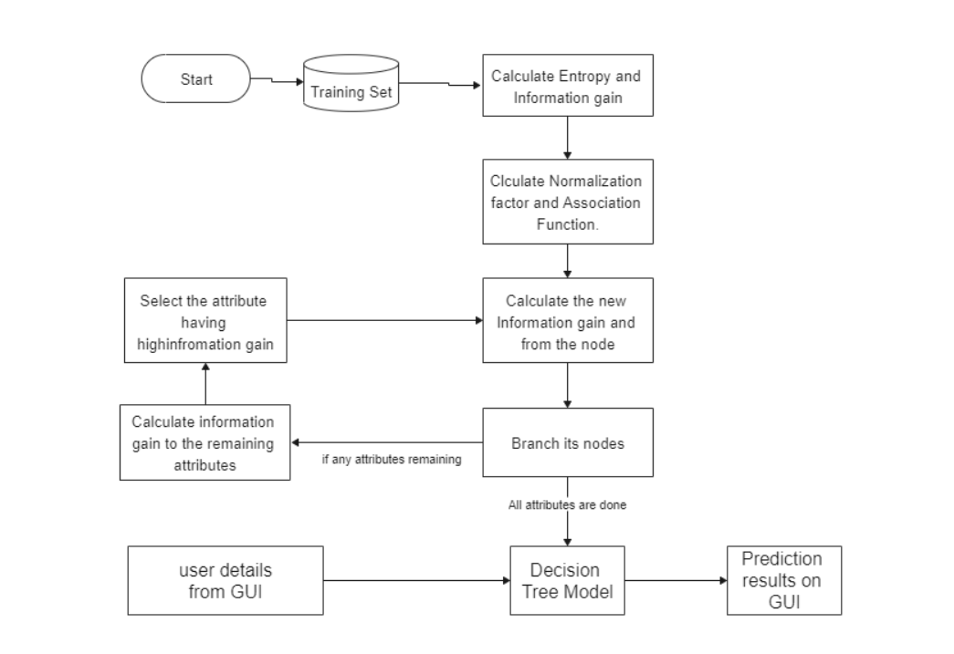
Architecture Diagram

Slide 16
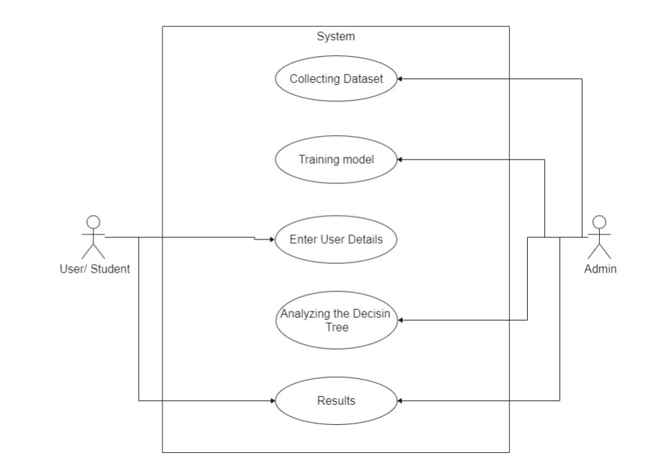
Use case Diagram

Slide 17
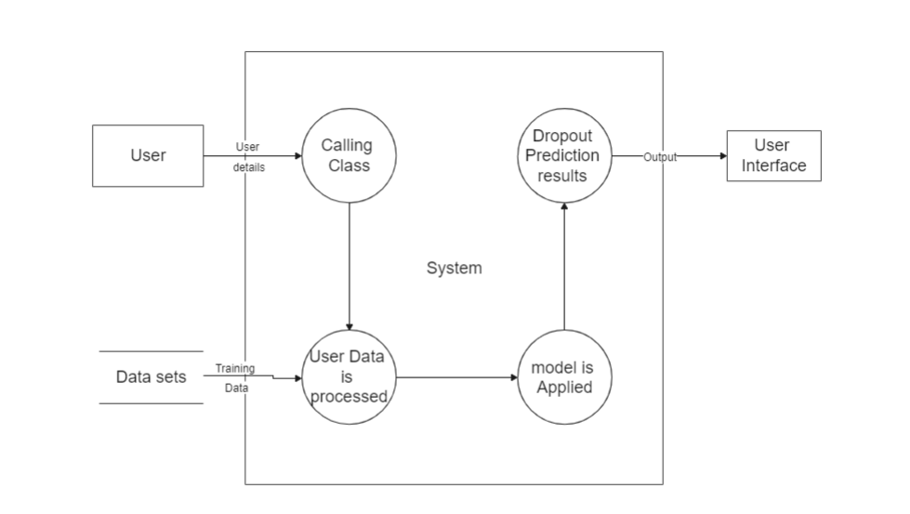
Data Flow Diagram

Slide 18
Design and Software used
Hardware Requirements:
Processor : Intel core i3
Hard disk : 4GB
RAM : 4GB
Software Requirements:
Operating System :Windows 7 or above
Browser : Google Chrome / Internet Explorer
Web Technologies: HTML, CSS, Node JS.
Editor : Visual Studio Code

Slide 19
Module Detail Explanation
Calling Class:
Calling class module includes the information collection from the user interface and it is having another work that it will take care about the data which is coming from the user is valid or not we will check here. Then finally if the data is valid then simply we will collect that data from the user and we give it to the decision tree algorithm.

Slide 20
Binary Node:
Here we are taking the information from the calling class and then we try to give that information to the model and the model predict something and we take that as output. We call this module as the binary node because here we do all these process by using the binary node decision tree. And finally we print this output to the user via user interaction page (GUI).

Slide 21
Decision Tree Module:
Decision tree module consists of number of tasks. It is the heart of our project. First we collect the dataset. We give this dataset to the model for training. First separates the data into parts based on the class label, and then it will calculate the information gain for each node. After calculating the information gain it will select the attribute which is having the best information gain value as the root node. And we take the data values and we assign as the children. Then again we calculate the information gain for the remaining attribute and try to take the best information gain to pick the next node. This process continues until all the attributes are finished on the tree. And finally the model is ready by forming a decision tree. The output of this module is the decision tree for given dataset.

Slide 22
Decision Tree Algorithm
Begin the tree with the root node, says S, which contains the complete dataset.
Find the best attribute in the dataset using Attribute Selection measure(ASM).
Divide the S into subsets that contains possible values for the best attributes.
Generate the decision tree node, which contains the best attribute.
Recursively make new decision trees using the subsets of the dataset created in step-3. Continue the process until we reached to the leaf node.
Attribute Selection Measure:
Information Gain.
Gini Index.

Slide 23
CONTINUE
Information Gain:
It is the measurement of changes in entropy after the segmentation of the dataset based on the attribute.
It calculates how much information a feature provides us about a class.
A decision tree algorithm always tries to maximize the value of information gain, and a node having the highest information gain is split first.
Information gain= Entropy(S)-[(Weighted Avg)* Entropy(each feature)]
Entropy is a metric to measure the impurity in a given attribute.
Entropy(S) = -p(yes) log2 P(yes)- P(no) log2 P(no)
Where,
S = Total number of samples
P(yes) = probability of yes
P(no) = probability of no

Slide 24
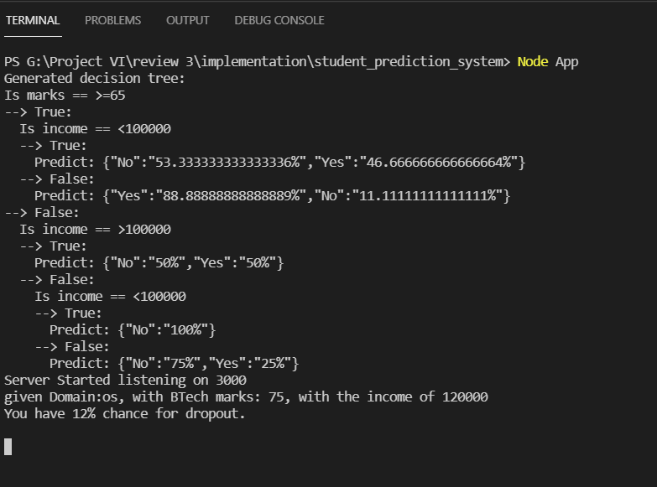
Experimental Results
Here we got the decision tree as the output from the given training data.
The results that are obtained finally are the rate of chance of dropout prediction of the student from the given test details by the user.

Slide 25
Result Analysis
The system is trained with the dataset, after training the model, the model generates a binary decision tree as output.
When Student accessing the system, after collecting the data from the student we will give that data to our model, then our model processes that data and provide a prediction of rate of chance of dropout as output.

Slide 26
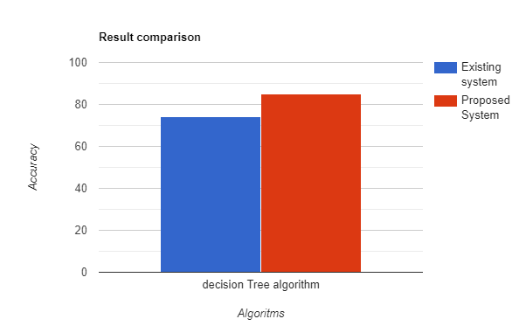
Comparison with Existing system

Slide 27
Conclusions and scope for future work
The Obtaining results suggest that the usage of the decision tree algorithm to predict the student dropouts is gives better accuracy. Here we trained the algorithm by giving 2 attributes as input and we got 85% accuracy. So if we include more parameters/features then there might be a chance of increasing the accuracy of the system.
Future work: Here we are taking the student graduation marks and income to predict the dropout rate. In the future, we can also add an examination interface to the system, and based on the examination results and the time log of the examination as the additional parameters to the decision tree algorithm. Then we have a chance of increase in the accuracy. And we can also add the authentication interface to system to provide the security.

Slide 28
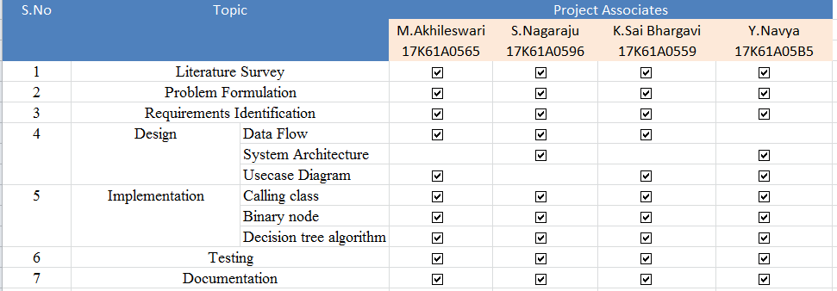
Contribution of the candidate

Slide 29
REFERENCES/BIBLIOGRAPHY
Shaojie qu1,Kan li2,Shuhui Zhang1,And Yongchao Wang3.” Predicting Achievement of Students in Smart Campus”, IEEE, Journal,Vol.06, pp:60264-60273,2018.
Antonio Jesus Fernandez Garcia, Roberto Rodriguez- Echeverria, Juan Carlos Preciado Jose Maria Conejero Manzano , and Fernando Sanchez-Figueroa .”Creating a Recommender System to Support Higher Education Students in the Subject Enrollment Decision”, IEEE Journal,Vol.08,pp.189069-189088,2020.
David Baners, M. Elena Rodriguez and Montse Serra, "An Early Feedback Prediction System for learners At-risk within a First-year Higher Education Course", IEEE Transactions, vol:12, pp:249-263, 2019.
Josep Figueroa- Canas and Teresa Sancho-Vinuesa, "Early prediction of dropout and final exam performance in an online statistics course", IEEE Transactions, vol: 15, pp: 86-94, 2020.
Camilo Ernesto López Guarín, Elizabeth León Guzmán, and Fabio A. González,“A Model To Predict Low Academic Performance at a specific Enrollment Using Data Mining”,IEEE,Journal,Vol.10,pp:119-125,2015.

Slide 30
CONTINUE
Abdullah Alshanqiti And Abdallah Namoun, “Predicting Student Performance and Its Influential Factors Using Hybrid Regression and Multi-Label Classification”,IEEE,Journal,Vol.08,pp:203827-203844,2020.
Jui-Long Hung, Morgan C Wang , “Identify At-Risk students for Early interventions-A Time Series Clustering Approach”. IEEE, 2017.
Rosa M. Carro , Alvaro Ortigosa, “From Lab to Production: Lessons Learnt and Real Life Challenges of an Early Student-Dropout Prevention System” IEEE, 2019.

Slide 31


